Slide 1

Music Recommendation System using Cosine Similarity
Parva V. Barbhaya – Rachit H. Mehta – Vishant K. Mehta – Abhishek N. Potdar
1814004 1814037 1814038 1814048

Slide 2

Introduction
The improvement in digital technology has led the music digitally available to all Internet users. The development of nanotechnology made storage devices portable, and nowadays, any handheld devices can store millions of tracks.
The recommender system acts as a savior and filters the songs that are suitable for that user at that moment. It also maximizes the user’s satisfaction by playing appropriate song at the right time, and, meanwhile, minimize the user’s effort.

Slide 3

Cosine similarity has its place in several applications and algorithms.
Some scenarios and applications where the cosine similarity measure is leveraged:
Document Similarity
Pose Matching
BIOINFORMATICS
Recommendation Systems
Applications of Cosine Similarity

Slide 4

Literature Review
Presently, millions of music tracks are available on the web. Therefore, a music recommendation system can be helpful to filter and organize music tracks according to the need of users. To develop a recommendation system, we need an enormous amount of data along with the user preference information. The idea is to present a lyrics retrieval system for Western songs using features collected from lyrics. An English lyrics dataset is collected from the web. The collected dataset is noisy, and several forms of a single word are present in it, thus it required filtering to remove the discrepancies and make the dataset uniform.

Slide 5

Methodology
Recommendations done using content-based recommenders can be seen as a user-specific classification problem. This classifier learns the user's likes and dislikes from the features of the song. The most straightforward approach is keyword matching.
In a few words, the idea behind is to extract meaningful keywords present in a song description a user likes, search for the keywords in other song descriptions to estimate similarities among them, and based on that, recommend those songs to the user.
In our case, because we are working with text and words, Term Frequency-Inverse Document Frequency (TF-IDF) can be used for this matching process. The number of times a term occurs in a document is called its term frequency (TF).
tf(t,d) = count of t in d / number of words in d
While computing TF, all terms are considered equally important. However, it is known that certain terms, such as “is”, “of”, and “that”, may appear a lot of times but have little importance. Thus, we need to weigh down the frequent terms while scale up the rare ones, by computing IDF, an inverse document frequency factor is incorporated which diminishes the weight of terms that occur very frequently in the document set and increases the weight of terms that occur rarely.

Slide 6
Methodology
idf(t) = log(N/(df + 1))
tf-idf now is the right measure to evaluate how important a word is to a document in a collection. It assigns a weight to every word in the document, which is calculated using the frequency of that word in the document and frequency of the documents with that word in the entire corpus of documents.
After this we use the cosine similarity library to find the similarity between lyrics of different songs. Cosine Similarity is a measurement that quantifies the similarity between two or more vectors. The cosine similarity is the cosine of the angle between vectors.
A scenario that involves the requirement of identifying the similarity between lyrics of a song is a good use case for the utilization of cosine similarity as a quantification of the measurement of similarity between two objects.
Quantification of the similarity between two lyrics can be obtained by converting the words or phrases within the sentence into a vectorized form of representation. The vector representations of the documents can then be used within the cosine similarity formula to obtain a quantification of similarity.
The cosine similarity of 1 implies that the two lyrics are exactly alike and a cosine similarity of 0 would point to the conclusion that there are no similarities between the two lyrics.

Slide 7

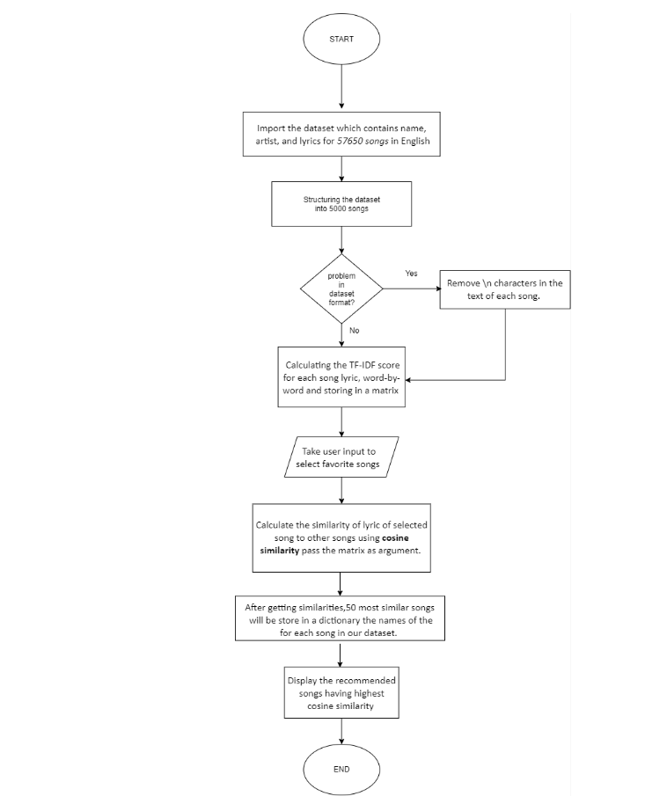
Flowchart

Slide 8

Tools and Libraries
Tools
Google Collab
Library
Numpy
Pandas
Sklearn
TfidfVectorizer
cosine_similarity
LINK: http://localhost:8888/notebooks/000/EDA%20IA/content_based_music_recommender.ipynb

Slide 9

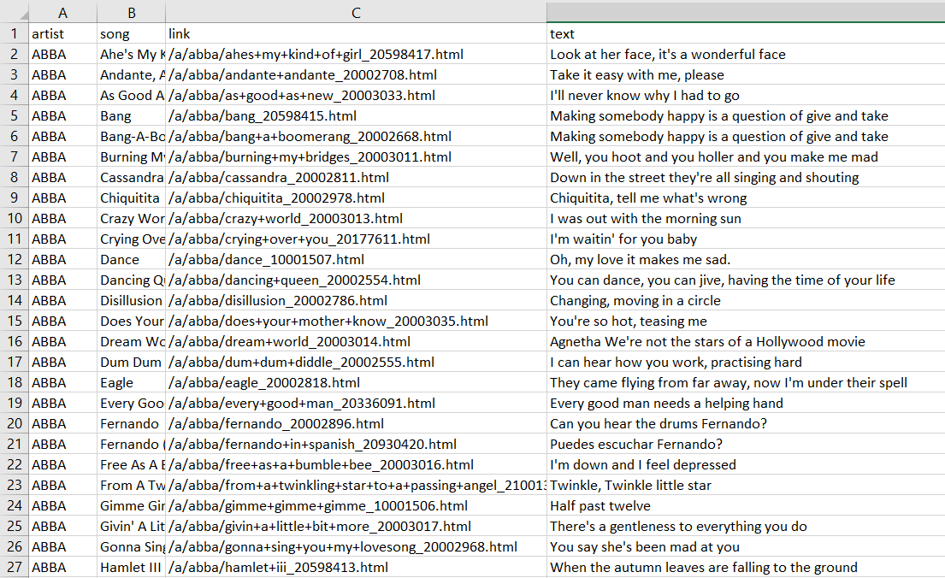
Dataset

Slide 10

Results
We executed music recommendation framework in python utilizing cosine similarity that suggests tunes dependent on the lyrics.
Series of words are changed over into vectors that are then coordinated with the data set of melodies to suggest the most fitting tune that the user will like.
Cosine Similarity is more helpful for occurrences when you don't need extent to slant the outcomes.
We believe that this research will facilitate the development of recommendation in music specifically for English songs.

Slide 11

Future Work
In future, the inter-cluster cosine similarity can be used for automatic evaluation. A weighted score can be assigned to each portions of lyrics (starting, middle, and end) for evaluation.
The mood words from lyrics can be collected using unsupervised approach such as word embeddings and the derived mood information can be used for ranking the results of similar lyrics retrieval system.
Ranking the retrieved lyrics is another important factor for recommendation system and is not considered during the evaluation of current system. It is one of the limitations of current developed system and ranking based evaluation can be implemented in future.

Slide 12

References
S Bandyopadhyay, D S Sharma and R Sangal, “Retrieving Similar Lyrics for Music Recommendation System” (2017), Proc. of the 14th Intl. Conference on Natural Language Processing, pages 290–297.
Maturu, Srikanth, "Application of Cosine Similarity in Bioinformatics" (2018). Computer Science and Engineering: Theses, Dissertations, and Student Research. 153
Harika Abburi, Eswar S. A. Akkireddy, Suryakanth Gangashetti, and Radhika Mamidi. 2016. Multimodal sentiment analysis of telugu songs. In Proceedings of the 4th Workshop on Sentiment Analysis where AI meets Psychology (SAAIP 2016), pages 48–52.
Jayson Beaster-Jones and Natalie Sarrazin. 2016. Music in Contemporary Indian Film: Memory, Voice, Identity. Taylor & Francis.
James Davidson, Benjamin Liebald, Junning Liu, Palash Nandy, Taylor Van Vleet, et al. 2010. The youtube video recommendation system. In Proceedings of the fourth ACM conference on Recommender systems, pages 293–296. ACM.
Yong Han, Li Min, Yu Zou, Zhongyuan Han, Song Li, Leilei Kong, Haoliang Qi, Wenhao Qiao, Shuo Cui, and Hong Deng. 2015. Lrc sousou: A lyrics retrieval system. In Proceedings of the International Conference of Young Computer Scientists, Engineers and Educators, pages 464–467. Springer.

Slide 13

Thank You

